Slide 1



Slide 2
RAM TECHNOLOGIES BANGALORE Email:
ramtechnologiesblr@gmail.com Mobile:
+91-8095888447 +91-9392559332

Slide 3
Trending Course!!!
AWS DevOps

Slide 4
DevOps Coaching Highlights
Myself: RAM
Having overall 10+ years of professional IT experience including 5+ Years in DevOps/Cloud computing/Automation.
Working as a DevOps Lead in one of the top IT service MNC companies in India.
Trained about 90+ students and Job support 120+ Professionals successfully past few years and many of my students got placed with many large enterprises
Comprehensive hands on knowledge on Linux, ShellScript, Git and Github, Jenkins, Maven, SonarQube, Nexus, Ansible, Docker, Kubernetes and AWS.

Slide 5
Insights!!
The DevOps requirements in the IT market space is expected to grow by 35% by 2024. Getting a DevOps education now is a great investment into your future, which will pay off very fast!
You are in the right place to kick start your career in DevOps. DevOps is one of the top and hot IT skills right now.
Currently almost all the employers are struggling to get right resources in their teams who can do the DevOps and automation work..
You could be that person by attending this trending program!!

Slide 6
Who can learn DevOps!!
DevOps is a set of practices and cultural philosophies that emphasizes collaboration, automation, and integration between development and IT operations teams. DevOps is not limited to a specific role or background; it can be learned and adopted by individuals from various disciplines.
Ex: Developers, System Administrators and IT Operations, Quality Assurance/Testers, Networkengineers, Anyone Interested in IT and Software Development

Slide 7
RoadMap to Become a successful DevOps Engineer
We all know how DevOps is trending right now. And we know where it is going. Let's get to know what skills will make you a successful DevOps engineer.

Slide 8
Top DevOps skills for 2023
1. Any cloud knowledge and experience - AWS, Azure and Google cloud
2. Linux knowledge and scripting - Basic troubleshooting, intermediate scripting, looking at the logs
3. Experience in Git, GitHub, Bitbucket or any version control systems such as SVN, TFVC
4. Experience in Continuous integrations tools such as Jenkins, TeamCity, Circle CI
5. Experience in Infrastructure automation tools such as Terraform, AWS cloud formation
6. Experience in Configuration Management tools such as Ansible, Puppet or Chef
7. Experience in containers such as Docker and Kubernetes
8. Experience in basic to intermediate Scripting. Advanced scripting needed for Sr.Devops folks.
9. Ability to troubleshoot in case builds, deployments failure.

Slide 9
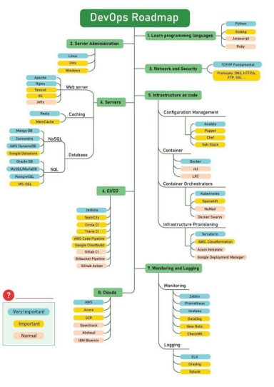

Slide 10
Soft skills
Now a days employers are not only looking for strong technical skills but also looking "soft skills" which are essentials to become successful in IT. If you think if you are lagging on any of these skills, no worries. All these skills can be developed and improved over period of time by practicing.
1. Open minded
2. Willingness to learn new skills
3. Communication
4. Approachable
5. "Get it done" attitude
6. Being adaptable.

Slide 11
Course Content
AWS
Create an account in AWS
services :
1.EC2
2.VPC
3.IAM
4.RDS
5.S3
6.ECR
7.EKS

Slide 12
Linux
Installing Pre-requisite Softwares (SSH Tools and FTP Tools) in Desktop/Laptop.
Understand Linux Command Line.
Linux File/Directory structure.
Linux Commands.
Files and Navigation
Permissions
Processes
Networking
Compressing
System info

Slide 13
Shell Scripting
^{Introduction}
^{What is Shell?}
^{Types of Shells}
^{What is Shell Scripting?}
^{First Shell Script program}
^{File Naming Conventions}
^{Comments}
^{Variables}
^{Command line Arguments}

Slide 14
Shell Scripting
^{Escape Characters}
^{String}
^{Arithmetic Operations}
User Interaction using read command
^{Input and Output Redirection}
^{Control commands – if}
^{Control commands – for}
^{Control commands – while loop}
^{Control commands – Switch case}
^{Functions}
^{Pipe}

Slide 15
SCM Tool-Git and GitHub
What is git?
What is the VCS?
What is SCM?
What is Branch?
What is Tag?
Git Administration.
Git commands
Working with git as a Developer perspective
SSH Key generation
PAT creation
Cloning Repositories
Merging Branches
Branching strategy
Best practices for Releases/Code commits in any VCS

Slide 16
Build Tool-Maven
Introduction
Features & Benefits of Maven
Installation (Maven Environment Setup)
Directory Structure
Content of pom.xml
Maven Repositories
Maven Life Cycles
Executing some Examples
Maven Multi Modules
Parent pom
Child pom

Slide 17
Apache Tomcat
Introduction
Difference between App server and Web server
Understating of Web Servers, App Servers and Database Servers
Installation (In Windows - Extraction, In Linux Installation)
Directory structure
Start the Tomcat server
Stop the server
Users creation
Roles
Port number change
Application Deployment
Through Admin Console
Copy artifact into webapps folder
Tomcat Tuning
Data source Creation

Slide 18
Code Quality Tool-SonarQube
Introduction
Pre-Requisites
Architecture
Installation
Change the Port Number
Execution
Administration
Users Creation (Normal User and Administrator)
Project Creation
Project deletion
Token Generation
Create Quality Profiles
Create Quality Gates
Configure Email settings

Slide 19
Artifactory Mgmt Tool-Nexus
Introduction
Installation
Password and Email change for Admin User
Email server Configuration
Port Number Change
Context root change
Nexus Directory structure
Create the Repositories (maven2hosted, maven2proxy, maven2group and docker..)
Integrate the Maven with Nexus
Create Users
Nexus API

Slide 20
CICD Tool-Jenkins
Introduction
Continuous Integration (CI)
Continuous Delivery (CD)
Continuous Deployment (CD)
Installation in Linux and Windows
Create the Maven Project using Freestyle Project type
Integrate Maven software if not done.
Integrate Nexus with Jenkins
Integrate SonarQube with Jenkins
Deploy the App into Tomcat
Through “Deploy to container” plugin
Through Script – SSH Agent Plugin
Configure Email Functionality
Poll SCM
Build Periodically

Slide 21
Jenkins
Git Web Hooks
Discard Old Build
Disable this project
Delete workspace before build starts
Add timestamps to the Console Output
JACOCO plugin
Plugin Management
Safe Restart
Next Build Number
Email Extension
SonarQube Scanner
Schedule Build
Artifactory Plugin
Cloud Foundry

Slide 22
Jenkins
Blue Ocean
Deploy to container
Deploy WebLogic
Maven Integration
JACOC
SSH Agent
Publish Over SSH
Thin Backup
Build Name Setter
Convert To Pipeline

Slide 23
Configuration Mgmt Tool-Ansible
Introduction
Architecture
ssh-key generation
Copy SSH Key
Ansible adhoc Commands
Ansible Playbooks
Execution of Ansible Playbooks
Ansible Modules
Roles
Ansible Vault
Ansible Galaxy

Slide 24
Container Tool-Docker
Docker Introduction
Containerization Vs Virtualisation
Docker Vs Virtual Machine
Docker Installation
Dockerfile
Dcoker Image
Docker Container
Docker Adhoc Commands
Docker Networks

Slide 25
Docker
Docker Volumes
Docker Keywords
Dockerfile Creation
Docker Images creation
Docker Images save to Dockerhub
Docker Compose
Docker Swarm

Slide 26
Container Orchestration Tool-Kubernetes
Kubernetes Introduction
Architecture
Kubernetes Cluster(Self-Managed) Setup Using Kubeadm.
Kubernetes Namespace
Kubernetes Objects o POD o Replication Controller o Replica Set o Daemon Set o Deployment Rolling Update Recreate o Stateful Set o Service o Volumes o Persistent Volume o Persistent Volume Claim o Dynamic Volumes o Config Maps & Secrets
HPA & Metrics Server
Kubernetes Cluster Setup In AWS Using KOPS
EKS Kubernetes Cluster Setup Using Terraform
Load balancer Service

Slide 27
Kubernetes
Ingress Controller & Resource
Liveness & Readiness probes
Kubernetes RBAC
Kubernetes & Jenkins Integration
Kubernetes Dashboard Setup
Helm
Monitor Kubernetes Using Prometheus And Grafana.
Log aggregation Using EFK

Slide 28


Slide 29
What is SDLC?
The Software Development Life Cycle (SDLC) is a well-defined procedure for producing high-quality, low-cost software in the shortest amount of time possible. The SDLC's purpose is to create exceptional software that exceeds all customer expectations and demands. The SDLC develops and describes a detailed plan that includes stages, or phases, each with its own process and deliverables. It describes the entire development process, including all tasks involved in planning, developing, testing, and distributing a software product.

Slide 30
SDLC
What is SDLC?
The Software Development Life Cycle (SDLC) is a well-defined procedure for producing high-quality, low-cost software in the shortest amount of time possible. The SDLC's purpose is to create exceptional software that exceeds all customer expectations and demands. The SDLC develops and describes a detailed plan that includes stages, or phases, each with its own process and deliverables. It describes the entire development process, including all tasks involved in planning, developing, testing, and distributing a software product.

Slide 31
SDLC MODELS
3 Types
Waterfall model-Monthwise
Agile or scrum Model-2 weeks
Kanban model-Everyday

Slide 32
Waterfall model
The waterfall model follows a linear and sequential approach to software development.
It consists of distinct phases, such as requirements gathering, design, implementation, testing, deployment, and maintenance.
Each phase is completed before moving on to the next, making it a rigid and structured model.

Slide 33
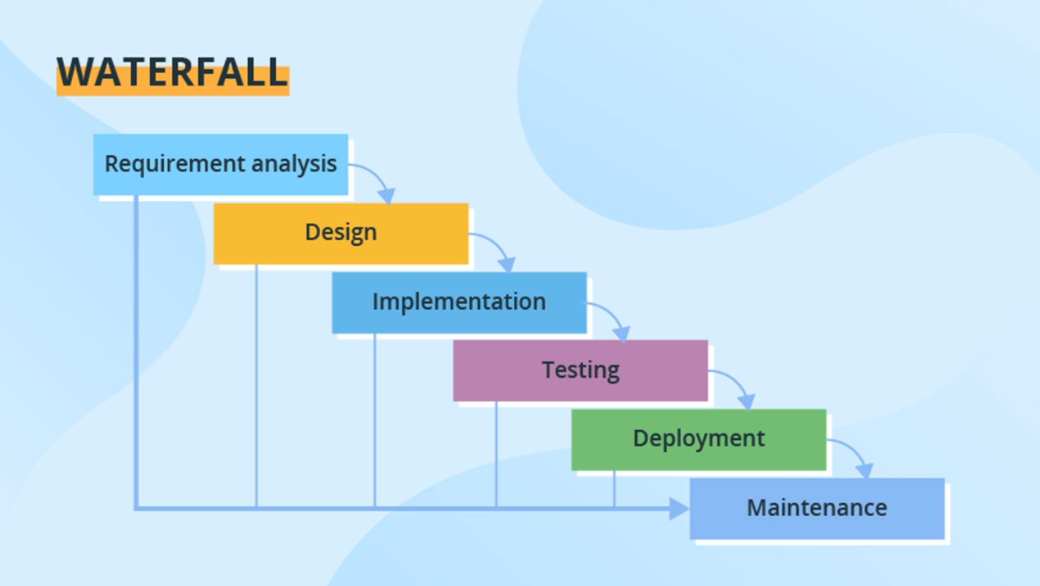

Slide 34
Agile or scrum Model
Agile is an iterative and incremental SDLC model that emphasizes flexibility, collaboration, and rapid delivery.
It involves breaking the development process into small iterations called sprints, where requirements, development, and testing occur concurrently.
Agile methods, such as Scrum and Kanban, promote adaptive planning and regular customer feedback.

Slide 35
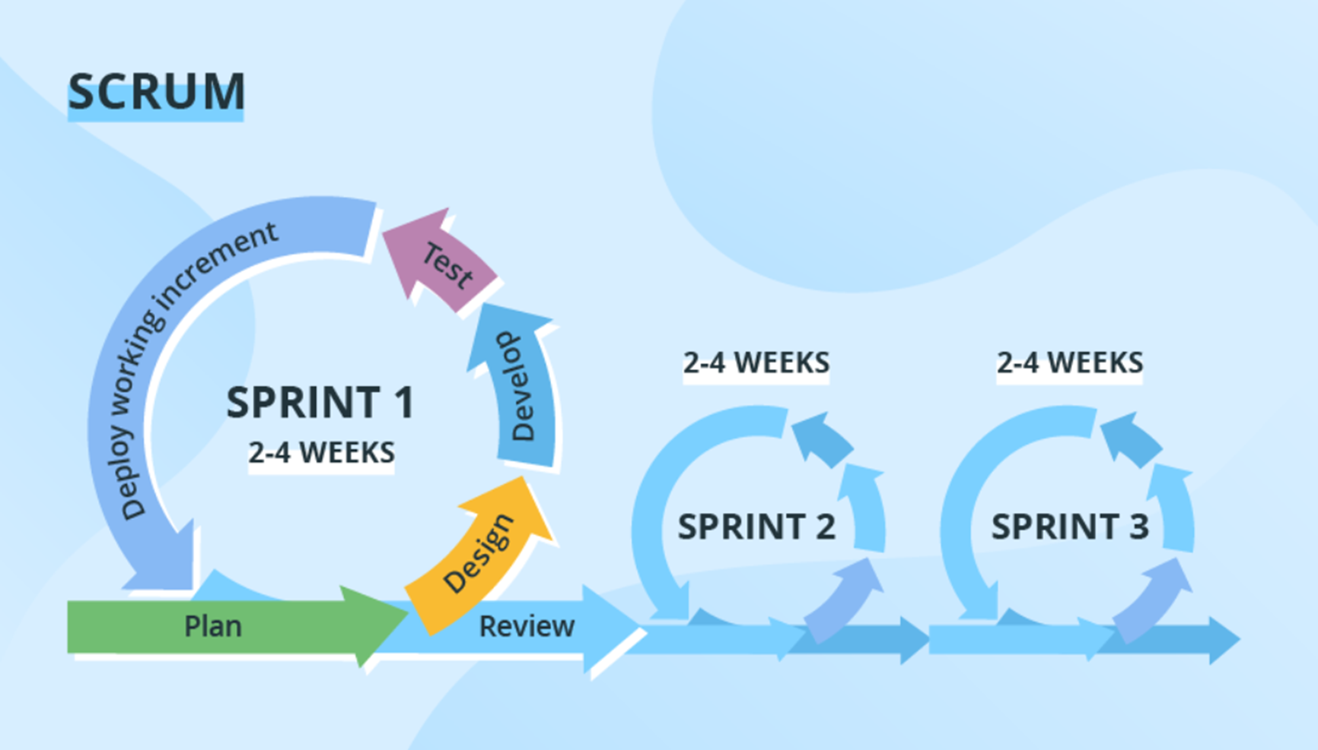

Slide 36
Kanban model
Kanban is a project management method that originated in the manufacturing industry but has been widely adopted in software development and other knowledge work domains.
It provides a visual framework for managing tasks and workflows, promoting efficiency, transparency, and continuous improvement

Slide 37
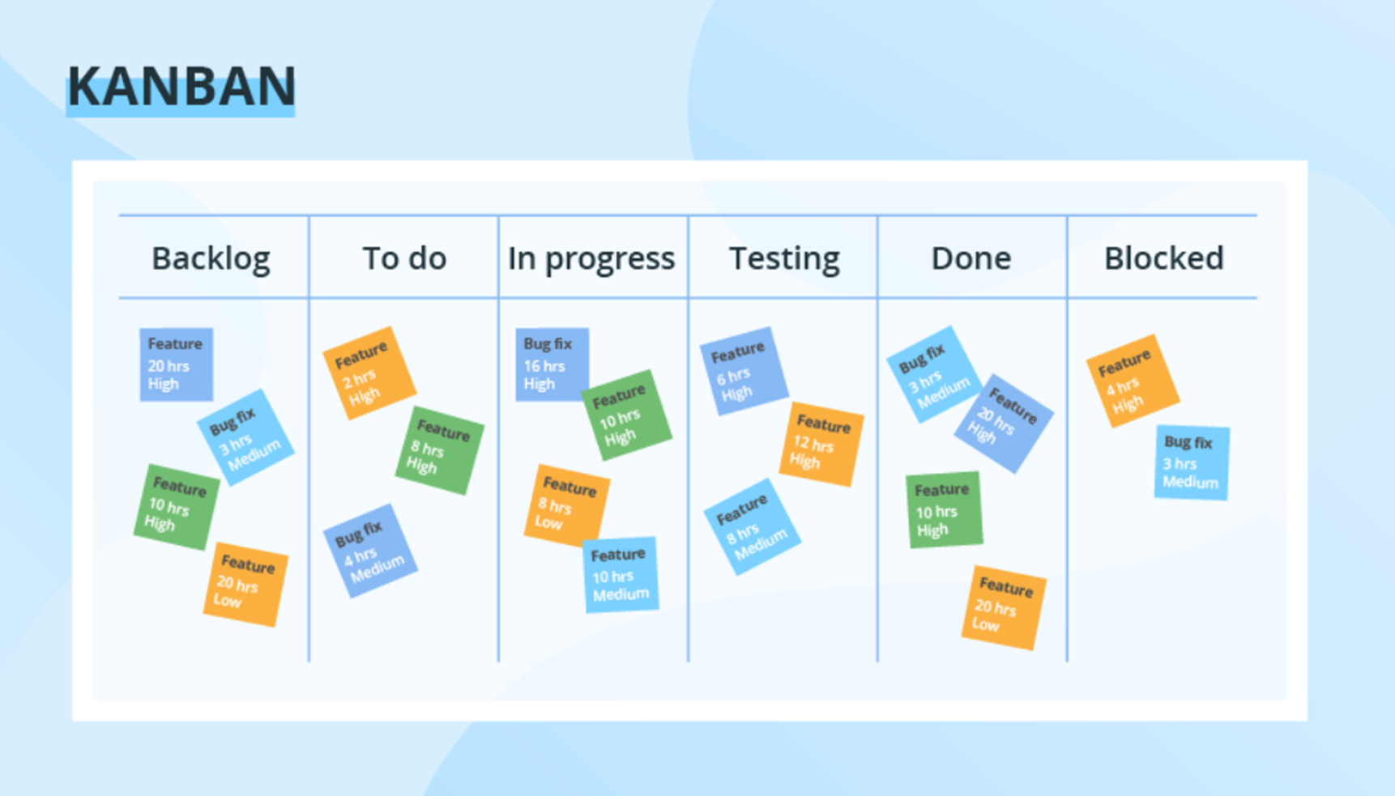

Slide 38
DevOps Vs Agile
Agile is a set of values and principles about how to develop software in a systematic way.
Where as DevOPs is a way to quickly, easily and repeatedly move that software into production infrastructure, in a safe and simple way.
In oder to achieve that we use a set of DevOps tools and techniques.

Slide 39
DevOps
DevOps is a methodology.
It is a combination of Development + Operations
DevOps is a combination of tools, practices and philosophies which enables organizations to release more features, services at high velocity with more frequency
DevOps helps you to reduce the disconnection between s/w developers, Quality Assurance (QA) engineers, and system administrators.
This allows a single team to handle the entire application lifecycle, from development to testing, deployment and operations. With the help of DevOps, quality and speed of the application delivery has improved to a great extent.

Slide 40
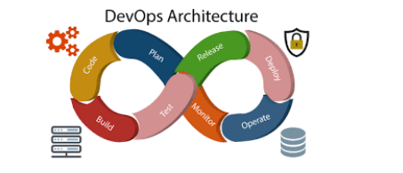
DevOps Architecture:It is used for the application hosted on the cloud platform and large distributed applications. Agile development is used here. So, that integration and delivery can be contiguous.

Slide 41
Features of Architecture
Automation
Collaboration
Automation can reduce time consumption, especially during the testing and deployment phase. The productivity increases and releases are made quicker by automation. This will lead in catching bugs quickly. So, we can fix easily.
The Development and Operations team collaborates as a DevOps team, which improves cultural model as the teams become more productive with their productivity, which strengthens accountability and ownership

Slide 42
Features of Architecture
Integration
Configuration Management
Applications need to be integrated with other components in the environment. The integration phase is where the existing code is combined with new functionality and then tested.
It ensure/make sure the application to interact with only those resources that are concerned with the environment in which it runs. The configuration files are not created where the external configuration to the application is separated from the source code. The configuration files can be written during deployment, or they can be loaded at the run time, depending on the environment in which it is running.

Slide 43
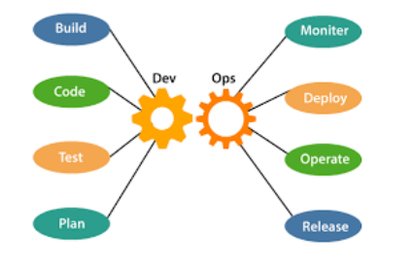
Components

Slide 44
Components
Below components are done by development team
Below components are done by Operations team
1. Plan
2. Code
3. Build
4. Test
1. Deploy
2. Monitor
3. Operate
4. Release

Slide 45
Devops-philosophy
Automate repetitive tasks and always thing for improvements
Don't work in silos make sure you collaborate and communicate on time with other members and teams.
Keep shorter software development lifecycles for example 2 weeks releases.

Slide 46
Devops - Life Cycle
DevOps defines an agile relationship between operations and development.
It is a process that is practiced by the development team and operational engineers together from beginning to the final stage of the product

Slide 47
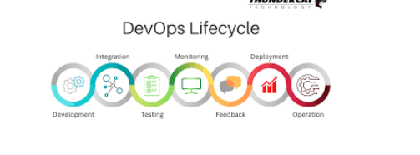

Slide 48
Seven Phases (7)
Continuous Development
Continuous Integration
Continuous Testing
Continuous Monitoring
Continuous Feedback
Continuous Deployment
Continuous Operations

Slide 49
Devops - Practices
Continuous Integration
Continuous Delivery
It is a development practice where developers should integrate changes
To their central repositories like Git daily to reduce conflicts and bugs.
It expands upon CI, it is automated process to deploy the code all the way from development to production Approval is required before promoting changes to production environment

Slide 50
Devops - Practices
Continuous Deployment
Configuration Management
Tt does not require approval
99% of customers don't follow this
Is a process where we maintain infrastructure and software changes through automation and
the goal is to maintain them in desired state.
For instance I wanna set up a tomcat server on 100 servers. This activity can be automated
using configuration management tool
It saves lots of time and it makes it easy to fix defects if any.
Popular configuration management tools are
Ansible, Puppet, Chef and Saltstack

Slide 51
Devops - Practices
Microservices Architecture
Monitoring
In this architecture big application(single code base) is divided into smaller services so that we get following benefits
We can release more services Development will be much faster We can scale any specific service alone
It is very important to monitor applications and services after it is deployed into production

Slide 52
What Are Benefits Of DevOps
DevOps is gaining more popularity day by day.
Here are some benefits of implementing DevOps Practice.
Release Velocity: DevOps enable organizations to achieve a great release velocity.
We can release code to production more often and without any hectic problems.
Development Cycle: DevOps shortens the development cycle from initial design to production.
Full Automation: DevOps helps to achieve full automation from testing, to build, release
and deployment.
Deployment Rollback: In DevOps, we plan for any failure in deployment rollback due to a
bug in code or issue in production. This gives confidence in releasing feature without
worrying about downtime for rollback.
Defect Detection: With DevOps approach, we can catch defects much earlier than
releasing to production. It improves the quality of the software.
Collaboration: With DevOps, collaboration between development and operations
professionals increases.
Performance-oriented: With DevOps, organization follows performance-oriented culture in
2/71
which teams become more productive and more innovative.

Slide 53
DevOps workflow
The typical DevOps workflow is as follows:
Atlassian Jira for writing requirements and tracking tasks.
Based on the Jira tasks, developers checking code into GIT version control system.
The code checked into GIT is built by using Apache Maven.
The build process is automated with Jenkins.
During the build process, automated tests run to validate the code checked in by a developer.
Code built on Jenkins is sent to organization’s Artifactory.
Jenkins automatically picks the libraries from Artifactory and deploys it to Production.
During Production deployment, Docker images are used to deploy same code on
multiple hosts.
Once a code is deployed to Production, we use monitoring tools like nagios are used to check the health of production servers.
Splunk based alerts inform the admins of any issues or exceptions in production.

Slide 54
What is Cloud Computing
It is the use of remote servers on the internet to store, manage and process data rather than a local server or personal computer. There are basically 3 categories in cloud computing
1.SAAS
2.PAAS
3.IAAS

Slide 55
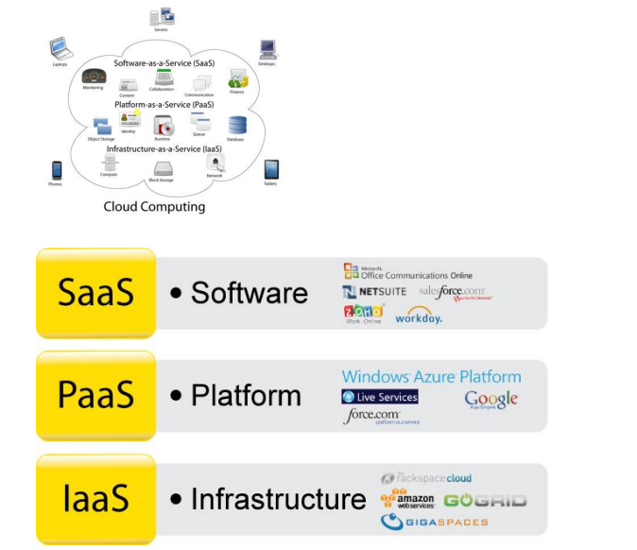

Slide 56
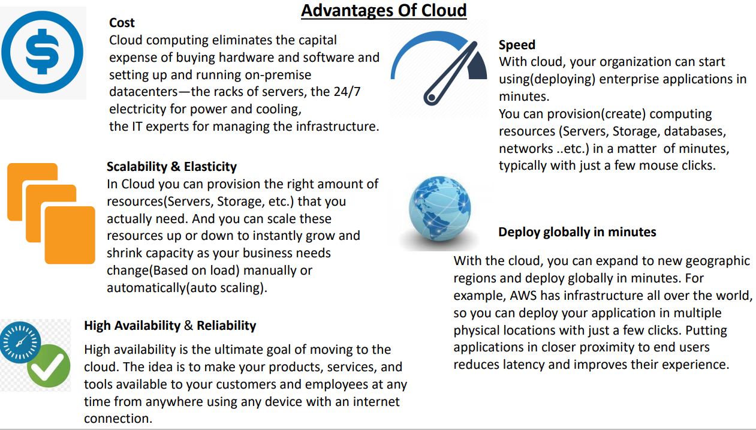

Slide 57
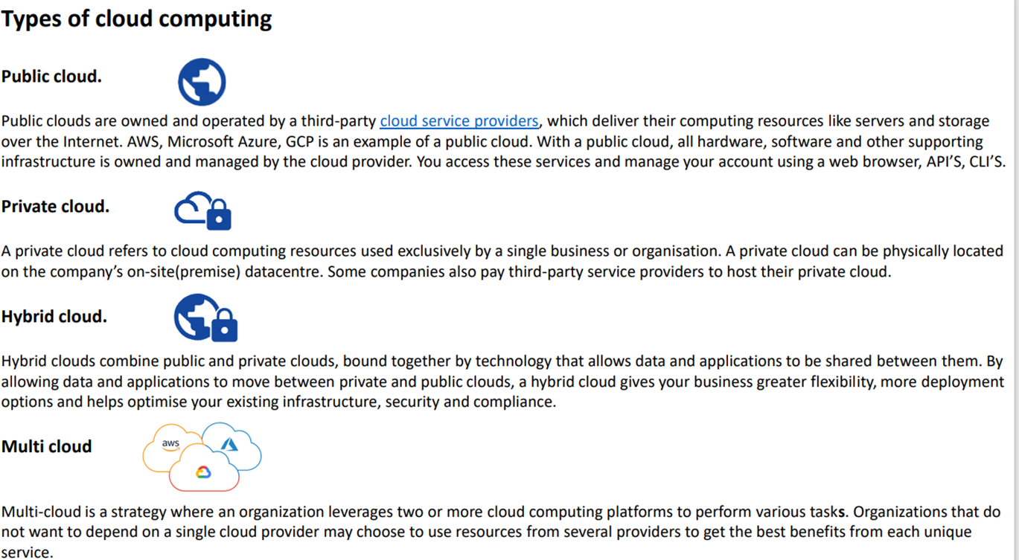

Slide 58
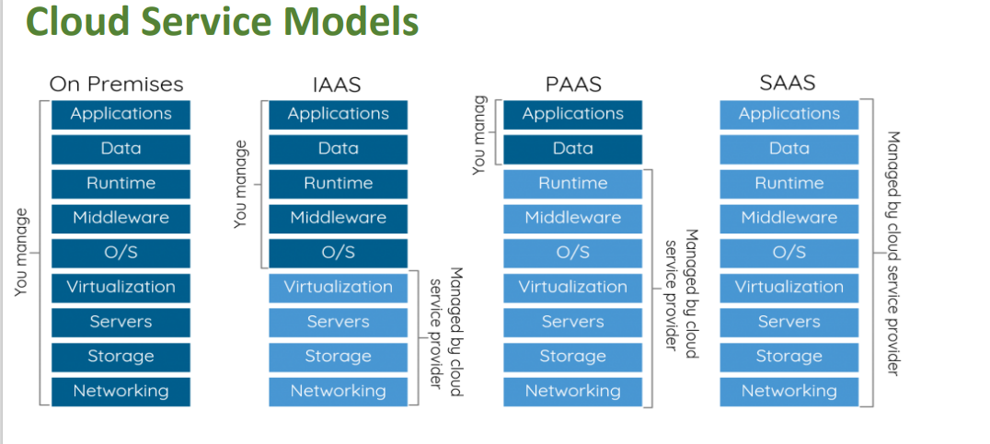

Slide 59
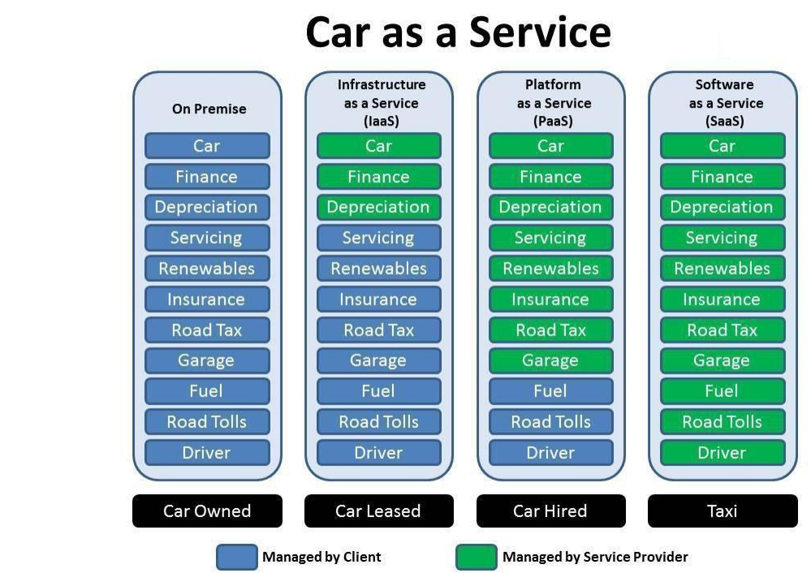

Slide 60
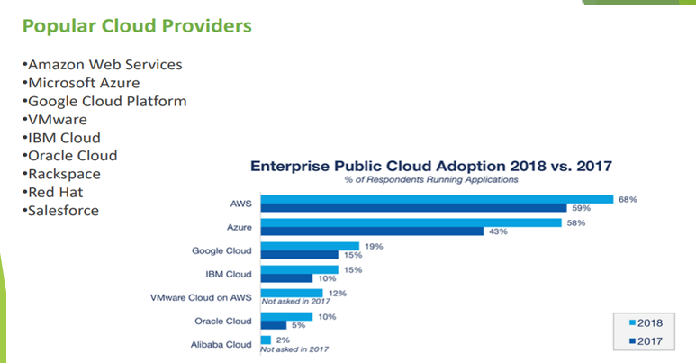

Slide 61
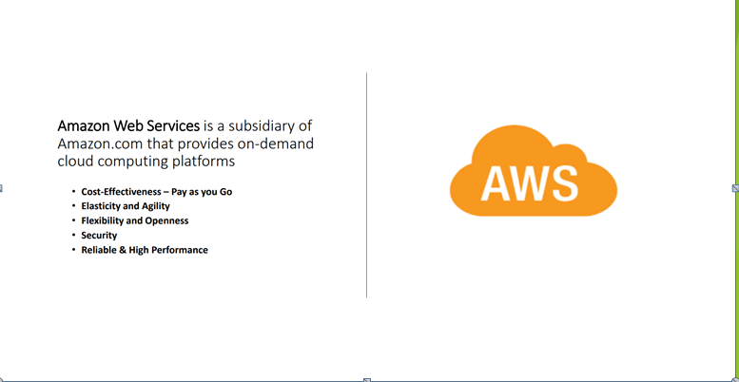

Slide 62
Uses of AWS
A small manufacturing organization uses their expertise to expand their business by leaving their IT management to the AWS.
A large enterprise spread across the globe can utilize the AWS to deliver the training to the distributed workforce.
An architecture consulting company can use AWS to get the high-compute rendering of construction prototype.
A media company can use the AWS to provide different types of content such as ebox or audio files to the worldwide files.

Slide 63
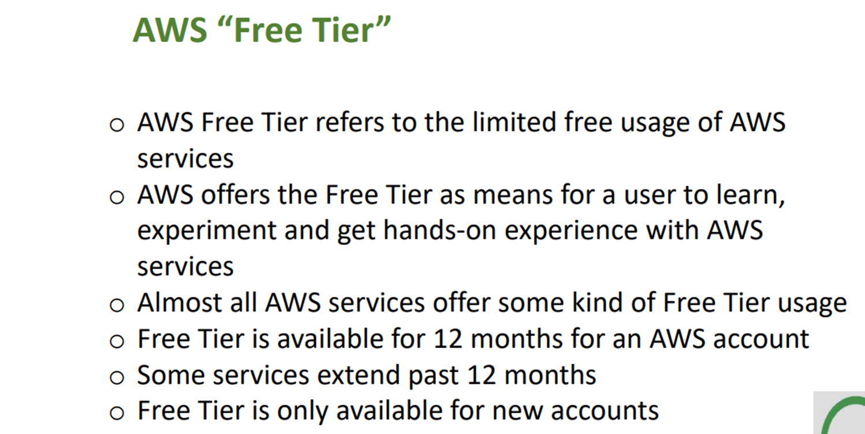

Slide 64
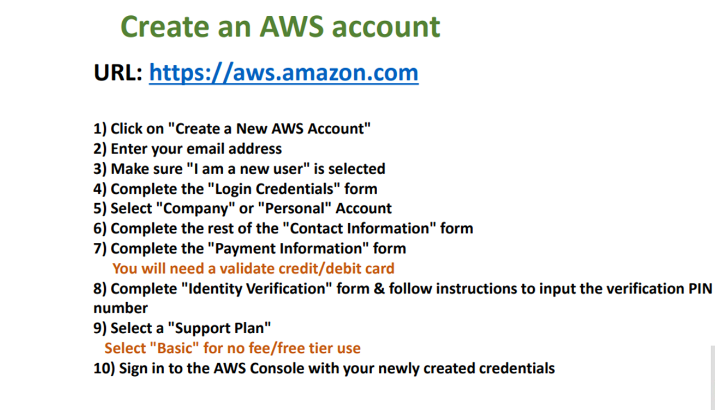

Slide 65
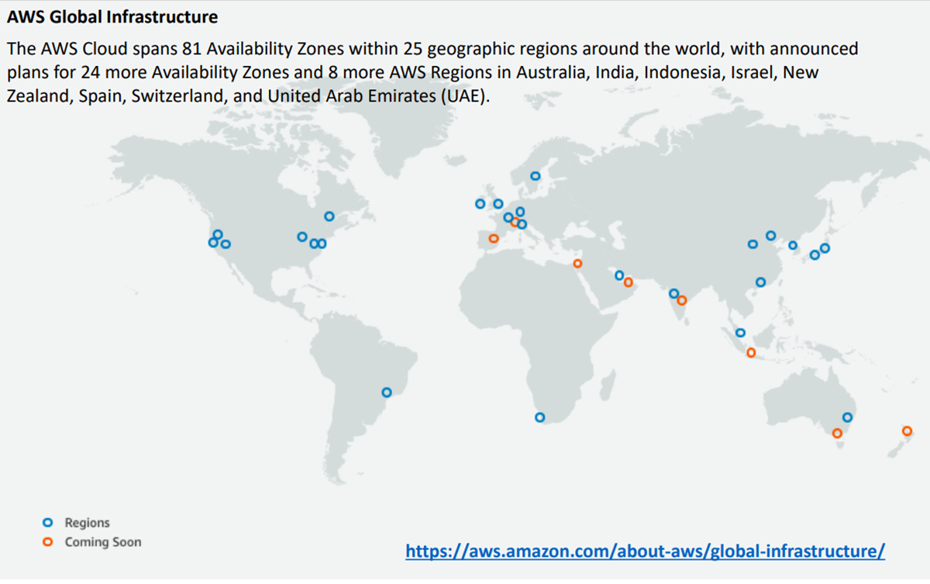

Slide 66
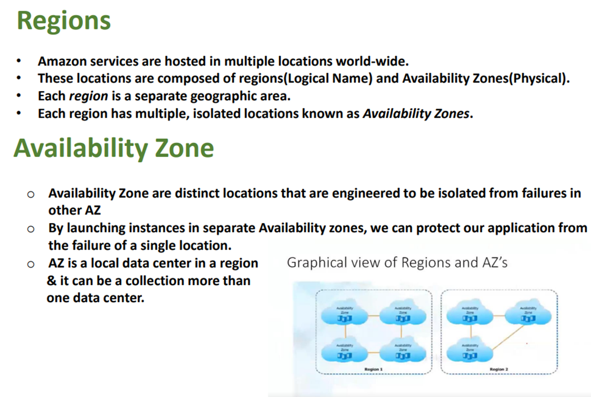

Slide 67
AWS SERVICES
EC2 — Elastic Cloud Computing
IAM — Identity and Access Management
VPC—Virtual Private Cloud
EBS—Elastic Block Storage
Rds — Relational Database Service
S3 — Simple Storage Service
Ecs — Elastic Container Service
Ecr — Elastic Container Registry
EKS--Elastic Kubernetes Service
CLOUD WATCH etc…

Slide 68
EC2
EC2 stands for Amazon Elastic Compute Cloud.
It is a web service which provides re-sizable compute capacity in the cloud.
It is designed to make the web scale computing easier for developers

Slide 69
AWS EC2 offers 5 types of instances
General Instances
Compute Instances
For applications that require a balance of performance and cost.
▪ E.g email responding systems, where you need a prompt response as well as the it should be cost effective, since it doesn’t require much processing.
t2
m4
m3
For applications that require a lot of processing from the CPU.
▪ E.g analysis of data from a stream of data, like Twitter stream
C4
C3

Slide 70
Memory Instances
Storage Instances
For applications that are heavy in nature, therefore, require a lot of RAM.
▪ E.g when your system needs a lot of applications running in the background i.e
multitasking.
R3
x1
For applications that are huge in size or have a data set that occupies a lot of space.
▪ E.g When your application is of huge size.
I2
d2

Slide 71
GPU Instances
For applications that require some heavy graphics rendering.
E.g 3D modelling etc..
G2

Slide 72
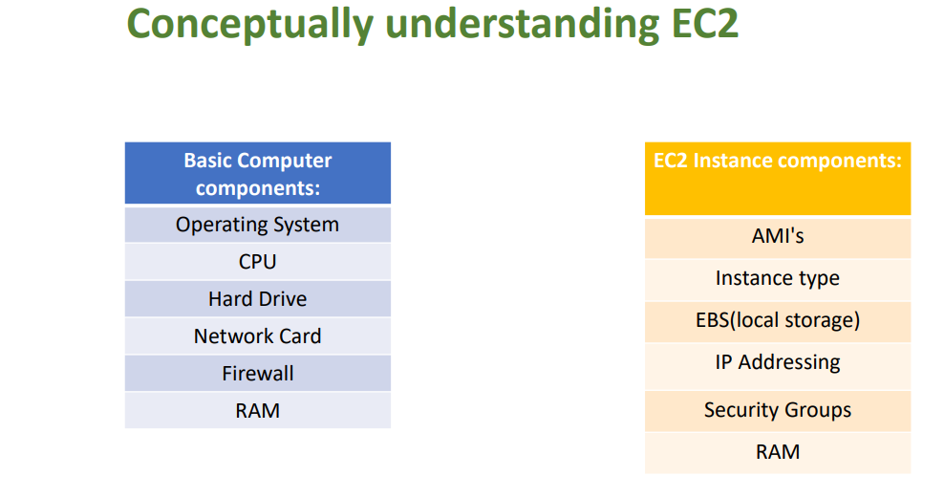

Slide 73
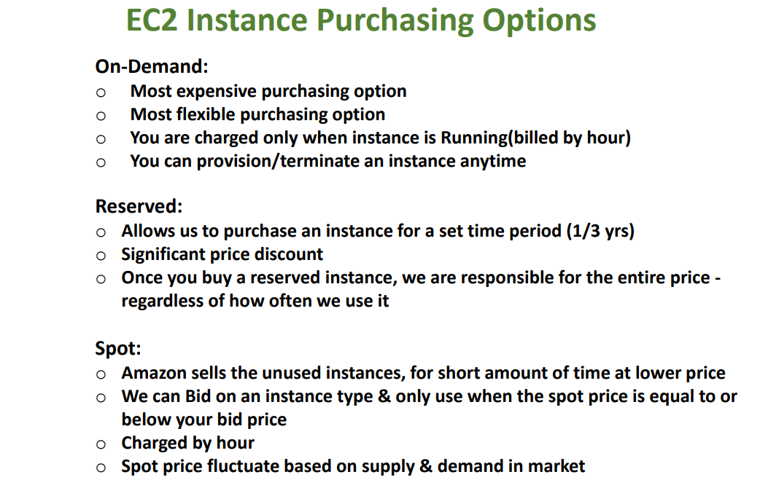

Slide 74
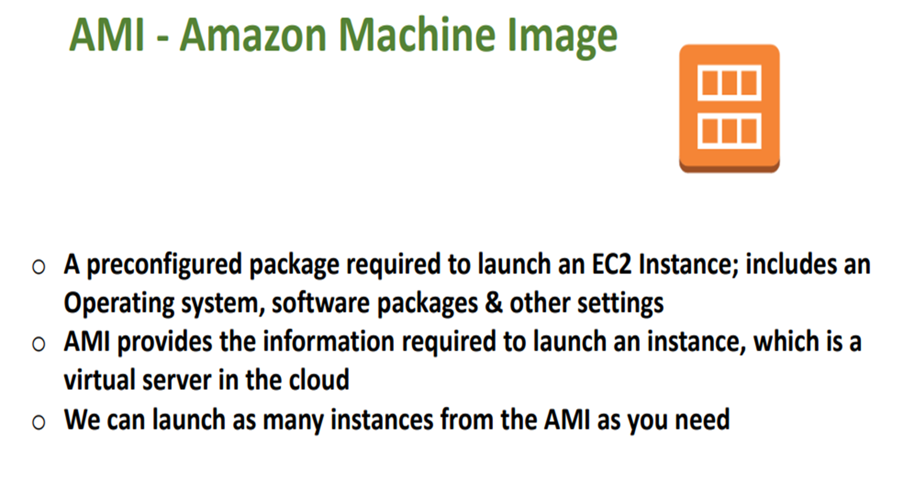

Slide 75
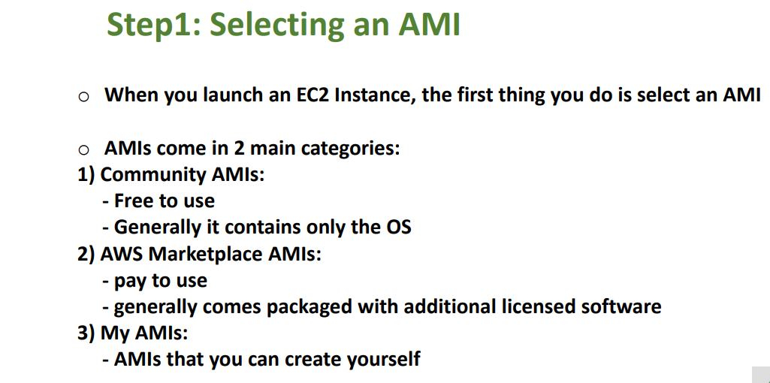

Slide 76
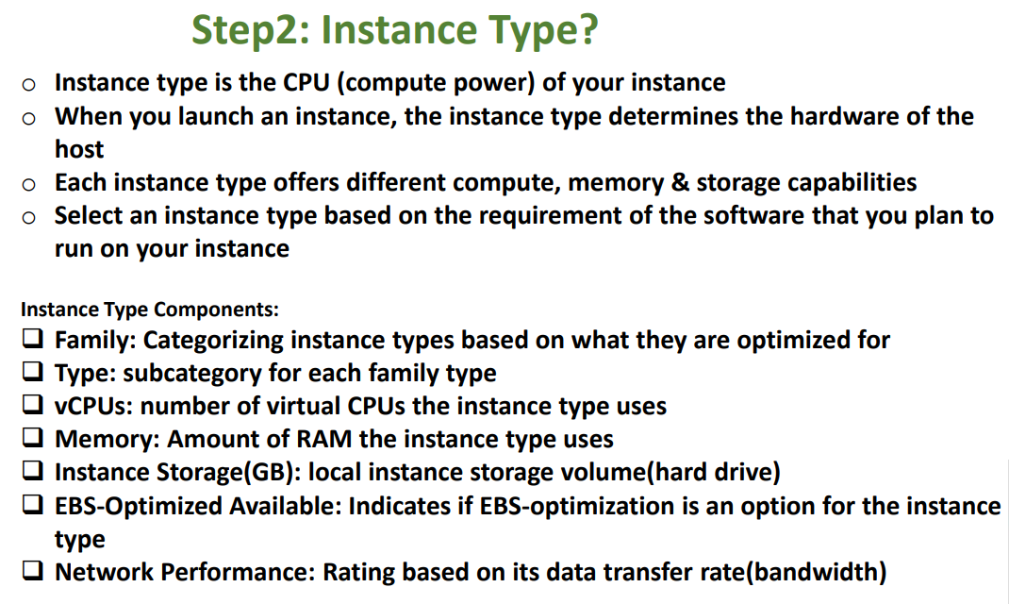

Slide 77
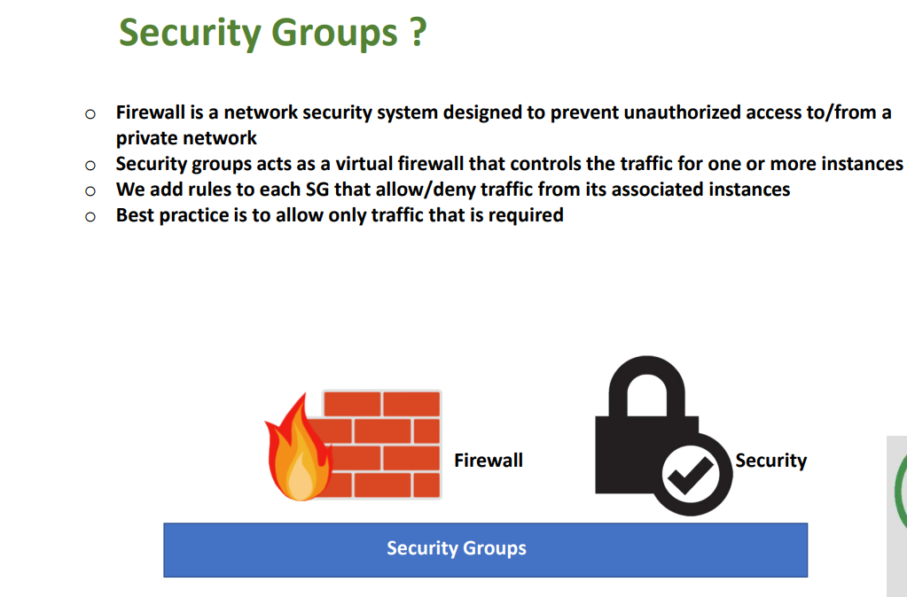

Slide 78
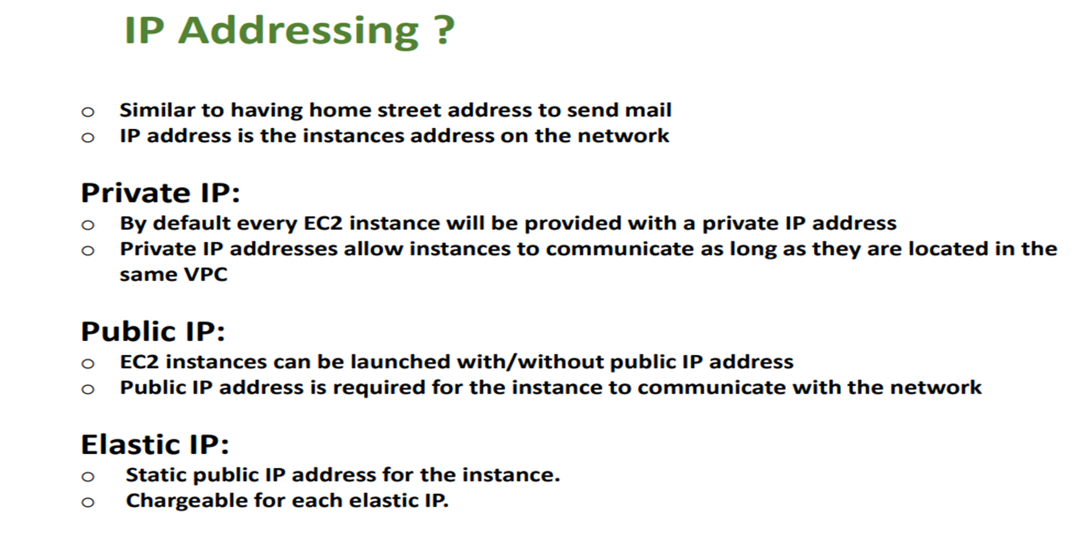

Slide 79
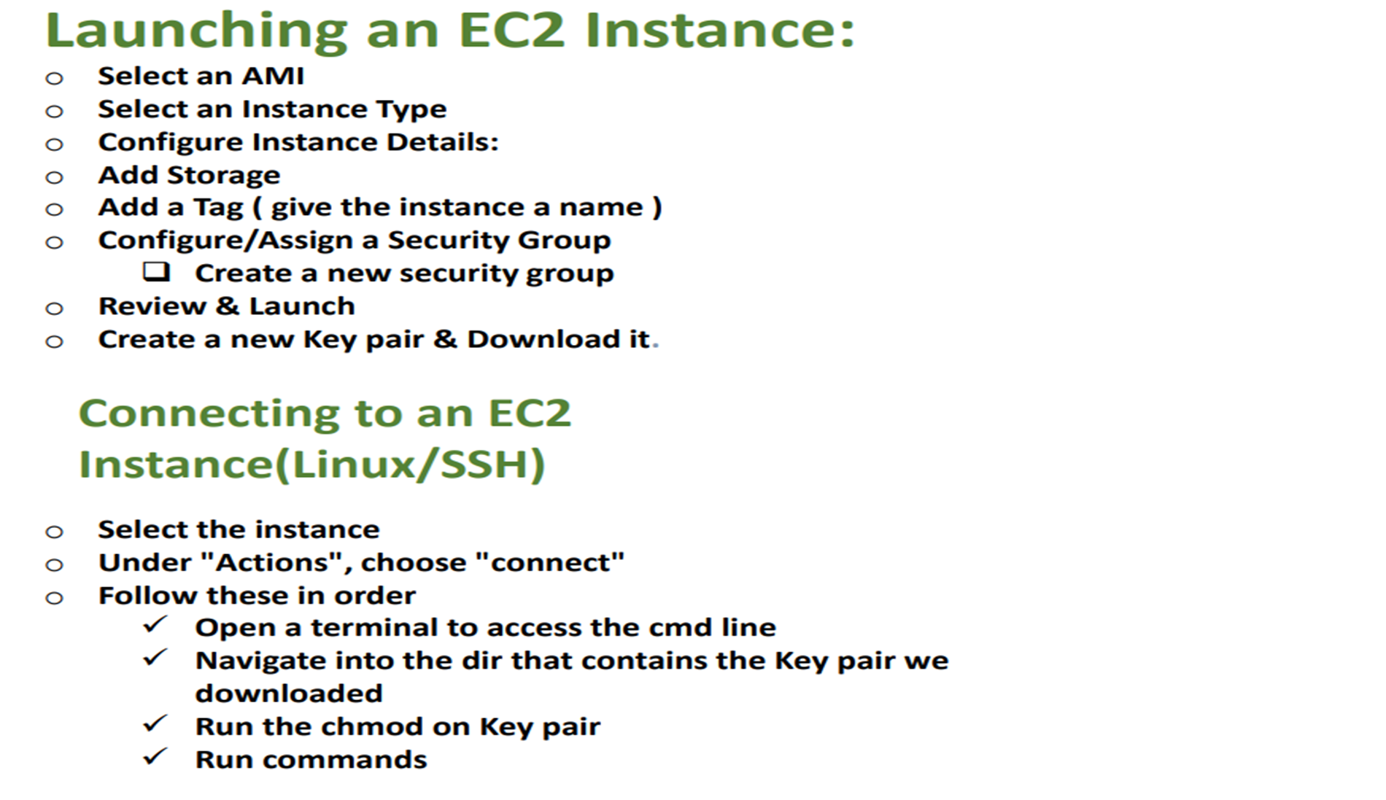

Slide 80
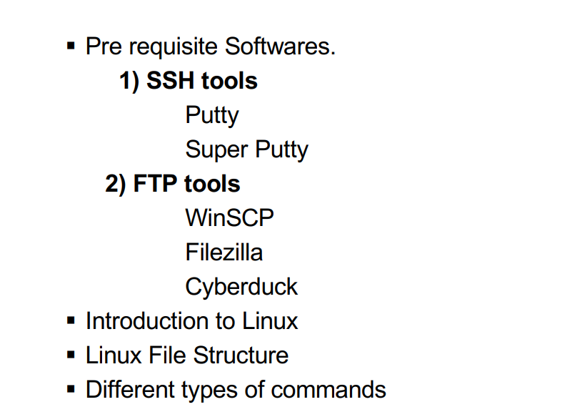
Linux

Slide 81
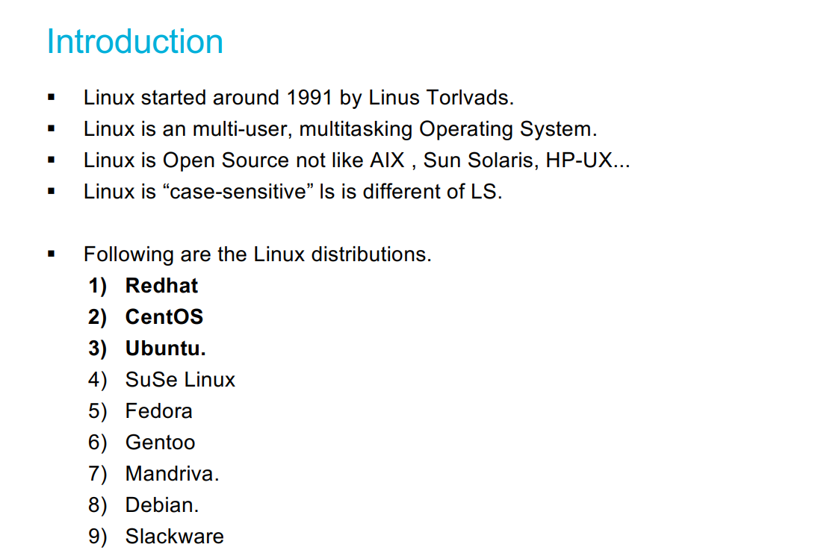
Linux

Slide 82
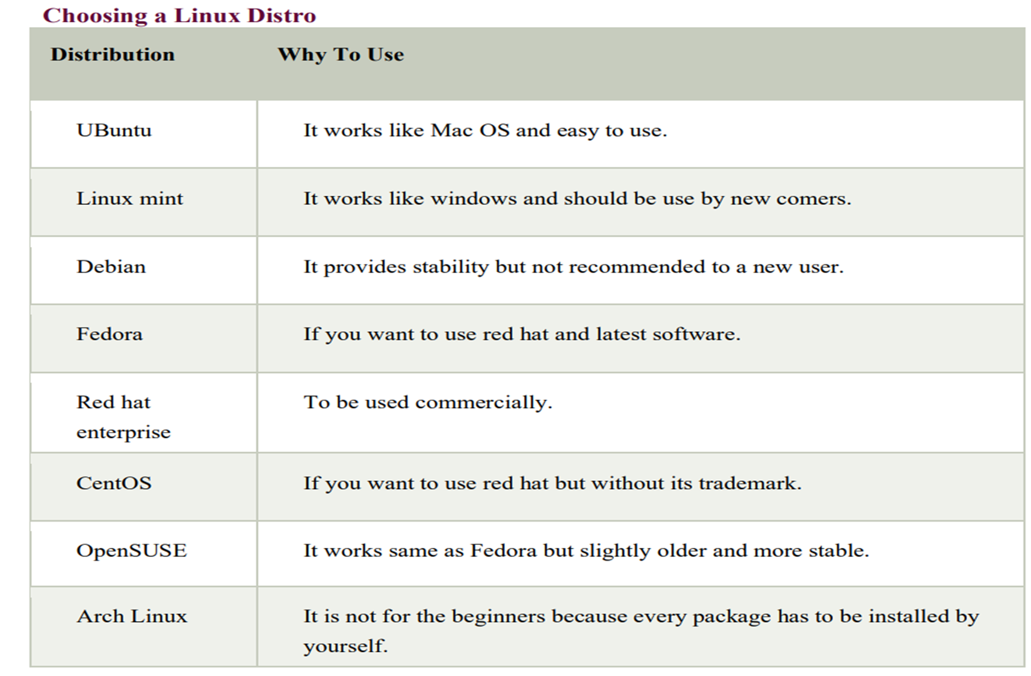

Slide 83
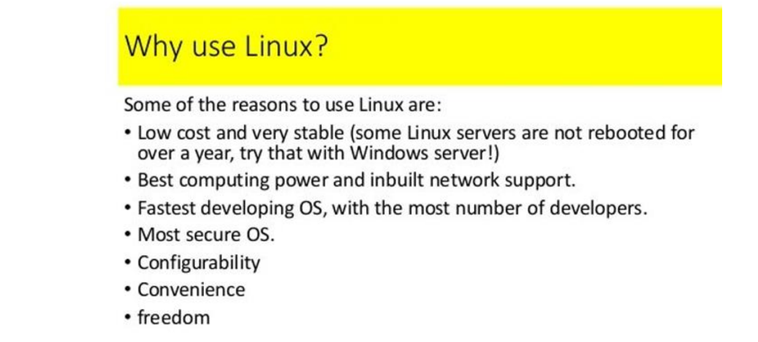

Slide 84
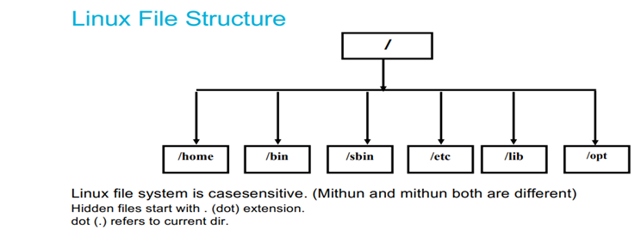

Slide 85
Linux File System
In linux everything is a file
Linux do not contain physical hard drive like windows
Linux has a logical hierarchical file structure
Linux is case sensitive
/ is the Root directory
Hidden files start with (.)dot extension
Dot(.) refers to current directory

Slide 86
1)/bin - In this binaries folder we are having commands
2)/opt - If we download 3rd party s/w in linux that will store in this optional folder
3)/boot - whenever you on the system, booting data present. So that boot code will present in this folder
4)/root - Root user data present
5)/dev - device folder - External devices info stored here
6)/home - Every user data stored here

Slide 87
7)/tmp - we can store the temporary data
8)/usr - In linux kernel info and system binaries info present in user folder
9)/lib - shareable files present in libraries folder
10)/sbin - system binaries -extra commands present when we compared to bin
11)/mnt - mount - If we put pendrive, usb from external that data is coming into this directory
12)/var - In this variable folder, all logs stored.

Slide 88
Linux Commands
i) System Commands
uname : used to get the Operating System of the server. Eg:- Linux, etc..
uname -r : Displays Linux kernel version
uname -a :Displays all information about Linux system information
uptime: Displays since how much time system has been running

Slide 89
uptime –s : Shows uptime in pretty format
hostname: Displays the hostname and IP address
hostname -i : Displays the IP address for hostname
date : Shows system date and time stamp
timedatectl : We will get the universal time
timedatectl set-timezone Asia/Kolkata :Changing the universal to local time
cal Displays the current calendar, month and day
cal 2023 : Displays the particular year calendar
cal 09 2024 Displays the particular month

Slide 90
last reboot :Shows system reboot history
who (or) w :Prints information about default user in our server
whoami Prints information about all users who are currently logged in
top : List out the running processors in our system
ip address (or) ip addr : Shows IP addresses assigned to all network interfaces
hostnamectl :we will get the hostname details

Slide 91
Hardware Commands
free :Displays system memory(RAM) details in KB
free -m :Displays system memory(RAM) details in MB
df -h :Report file system disk space usage i.e., how much memory we took and how much we consume, we will get all the details.
du :filename disk usage file name
du -sh filename disk usage file name
ps :To see all the running process
Kill -9 PID To kill the process
dmesg Bootup messages

Slide 92
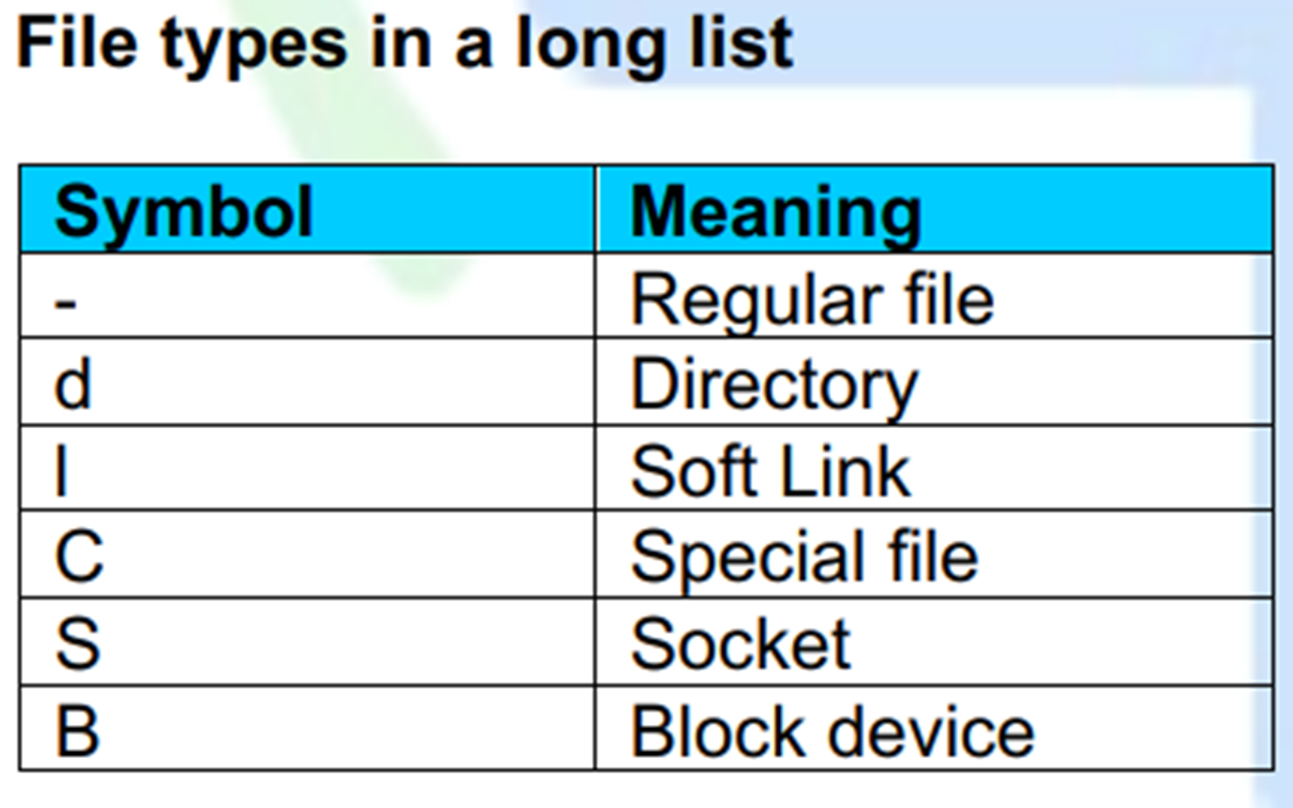

Slide 93
Default colour schemas for files types
Colour | File type
Blue | Directories
White | Text files
Pink | Images
Yellow | Devices
Flashing Red | Broken Links
Red | Compressed archives
Cyan | softlinks
Green | Executables

Slide 94
File Commands
touch filename :used to create a single file
touch f1 f2 f3 :used to create multiple files
touch file{1..5} create 5 files at a time
rm filename :used to remove single file
rm f1 f2 f3 :used to remove multiple files
rm file{1..5} used to remove 5 files
m -f filename used to remove a file without our permission
rm -f * :used to remove all files at a time

Slide 95
Folder or Directory commands
mkdir command
- make directory
- used to create a new folder
- can create multiple folders at a time
- folders with hierarchy
Eg: mkdir folder used to create single folder
mkdir devops
mkdir folder1 folder2 :used to create multiple folders
mkdir folder{1..7} create 7 folders at a time

Slide 96
mkdir with Options
mkdir -p a/b :create folder b inside folder a if a is present otherwise it will first create a then b inside a
rmdir folder :used to remove empty directory
Ex: rmdir devops
rmdir * used to remove all empty directories
rmdir -rf folder/* used to delete all the files inside the folder
rmdir -rf folder/filename used to delete the particular file inside the folder
rmdir -rf folder/filename used to delete the particular file inside the folder
rm -rf * used to remove all files and folders at a time
touch folder/filename used to create a file inside the folder

Slide 97
Changing Directories
cd foldername :used to change the directory
cd .. used to go back to one step back
cd ../../.. used to go back to 3 folders back
cd - used to go back to the previous directory
cd (or) cd ~ used to go back to root directory at a time
cd (or) cd ~ used to go back to root directory at a time
pwd :present working directory. If you want to check the current path use this command

Slide 98
ls command
ls :used to see only file names
ll (or) ls -l used to see all the files along with the data (l - original list)
ls folder1 :used to see the list of files present in folder1
ll -a (or) ls -al :used to see the both hidden and regular files
ll -r (or) ls -r used to see the files in reverse order
ll -r (or) ls -r used to see the files in reverse order
ll -ltr To list the files in long listing format with sort by modification time, newest first and then in reverse order

Slide 99
COPY
cp file1 file2 used to copy the data from source file1 to destination file2
Note: Here, if file2 i.e.., destination file is not created also, it will create automatically
Ex: cp test.sh test1.sh
cp file1 folder1 :used to copy the file to folder
Ex: cp test.sh devops

Slide 100
mv (MOVE) command
mv file1 file2 :used to move/renaming the files i.e.., the data from file1 to file2
Ex mv test1.py test2.py
mv file1 folder1 :used to cut the file and paste in folder
mv test2.py devops
cmp file1 file2 :used to compare the 2 files
diff file1 file2 :used to get the differences of a file b/w 2 files

Slide 101
cat command
cat filename used to read the data into a file
Ex:cat test.sh
cat f1 f2 f3 used to see all the files data at a time
Ex: cat test.sh test.py test.java

Slide 102
tac command
tac filename : reverse the data from top to bottom
Ex: tac test.sh
rev filename :reverse the data from left to right

Slide 103
head command
head filename used to print first 10 lines of a file
Ex: head test.txt
head -n 8 filename prints 8 lines in a file

Slide 104
tail command
tail filename used to print last 10 lines of a file
Ex: tail test.txt
tail -n 4 filename :used to print last 4 lines in a file

Slide 105
wc command
wc filename :used to get the no of lines, words, letters in a file
Ex:
wc -l filename used to get only line numbers of a file
wc -w filename used to get no of words in a file
wc -c filename used to get no of characters in a file

Slide 106
more command
Used to display content of large/very large files, In form of pages
more command loads the entire file at a time into memory
Used to see the multiple files data at a time
Used to see all the files data at a time with % press space enter or traverse
eg: more f1 f2

Slide 107
less command
large/ very large display files in form of pages
It will loads the parts of the data into memory that is displayed
we do have search capability use /word name, After perform less command
eg: less filename
When compare with less/more user prefer less command because we got some free space in memory/ram
our ultimate aim is If ram is free means system is speed

Slide 108
locate
It is light weight command, used to find a file
It searches for given file in backend database which updates once in a day
problem when we search for a newly created file
#sudo updatedb - used to update the database
#locate filename

Slide 109
find command
used to search for a file/folder
Find do not depend on any database if actually searches on file system
Find provides multiple options for searching a file eg: name, size, group, user, date, permissions, etc..,
Note:- Some times you are trying to find some files you got permission denied errors, On that case use sudo before the command
find path(or)pathType -name filename
find / -name file
find / -iname f1
find /home/ec2-user -name file
find / -type d -name fol-name
find / -type f -perm 0644

Slide 110
grep command
Global Regular Expression print
It is used to search for a word inside a file, without going inside a file
grep "searchwordname" filename
grep -n "wordname" aws
grep -i "wordname" aws
grep "wordname" aws -c (wordcount)
Search multiple words inside a file
grep -e "1stword" -e "2ndword" filename
grep -e "1stword" -e "2ndword" filename
grep -e "wordname" file1 file2
search multiple words and multiple files
grep -e "word" -e "word" file1 file2

Slide 111
File Modifications or Editors
Vim editor: It is used to modify the data in a file.
It has 3 modes
command mode
Insert mode
save & quit mode

Slide 112
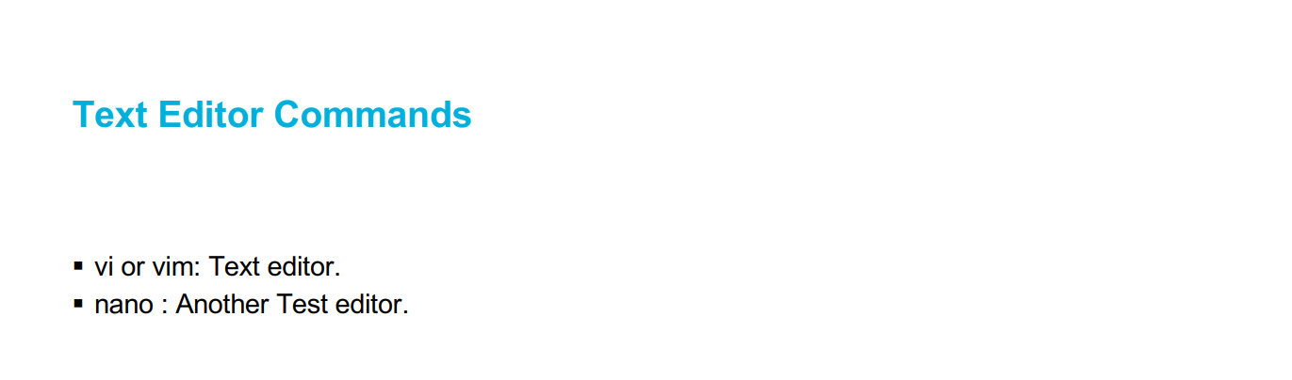

Slide 113
vi or vim editor
1. command mode
It is the default mode in vim editor. It is used for operations like copy, delete, paste the lines in a file
keys/commands:
In linux we can't press the keywords directly. you have to do in esc mode
yy : used to copy the entire of the line
3yy: copies 3 lines from our cursor
p : used to print the copied data
4p : it will print 4 times
dd : used to delete the entire line
5dd: used to delete 5 lines
gg : used to go to the 1st line of the file
G : used to go to the last line of the file
5gg: our cursor goes to the 5th line
shift:8 -> our cursor goes to the 8th line
u : used to undo the changes
ctrl+r : used to redo the changes
shift:set number -> used to give the numbers in a file
/word or ?word -> used to search a word
shift:%s/old word/new word/g -> to replace a word (g - global)

Slide 114
2. Insert mode
Used to insert the data in a file
esc: used to go to insert to command mode
i : used to go to command to insert mode
O : used to create a new line (up)
o : used to create a new line (down)
A : used to go to the end of the line
I : used to go to the starting of the line

Slide 115
3. save & quit mode
It is used to save the modified data in a file
And quit from the VI editor to root user
:w - used to save the data in a file
:q - used to quit from the vim editor
:wq - used to save & quit from the vim editor
:w! - forcefully save the data in a file
:q! - forcefully quit from the vim editor
:wq! - forcefully save & quit from the vim editor
Note: All these vim keys will work on command mode
4. visual, reverse, record modes - we don't use here

Slide 116
Nano editor
Its another editor in linux
Ex: nano text.sh
You can directly add or modify or delete the data in a file
For saving the file: ctrl+o hit enter
For exit: ctrl+x quit the file

Slide 117
User Management
Adding user
using adduser/useradd command
used to add a new user into linux os
Eg: adduser username
adduser -u 8765 pop
adduser -u 6578 -gid 8765 bob
note: whenever we create user, one group also will gets created with the same
whenever we create user, Inside /home automatically folder will gets created with same name

Slide 118
Backend process
controller will edit the following files
/etc/passwd - contains info about users in linux OS. we can see the users in our servers. First, last are the actual users. In
b/w there are system user accounts we called as daemons.
/etc/shadow - users password info present
/etc/group - contains info about groups in linux OS
/etc/gshadow - groups password info present

Slide 119
Removing user
using userdel command:
user delete
used to remove a user from linux os
Eg: userdel dhoni
userdel -r virat - delete user in both server & home directory
userdel -r -f rohit
delete user in both server & home directory and also deleted user related files
note: - whenever we delete the user, only user is deleted not the folder
At a time, we can delete single user only

Slide 120
File Permissions
- If you want to give all permissions to the file
- very important
- directly impact on security of os
using chmod command
change mode
used to change permissions for a file

Slide 121
Permissions in OS
read(r) : we can access data inside file/folder = 4
write(w) : we can change /alter data in file/folder = 2
execute(x): we can execute/ run file = 1
- : type of a file = 0
permissions are given to three set of people
owner(u): who actually creates the file/folder
group(g): every user is associated with a group
others(o): everyone other than group and owner comes under others
ls -l
drwxrwxrwx d : file / folder rwx : permissions of owner rwx : group permissions rwx : other permissions

Slide 122
we can change permissions of a file/ folder using 2 ways
1. using operators
+ : add a permission
- : removes a permission
= : replicates permission
Eg: chmod u+x file
chmod u-x,g+w,o+r abc
chmod u=rwx abc
chmod a+x abc

Slide 123
2. using numeric codes
rwx
000 - 0 - no permissions
001 - 1 - execute
010 - 2 – write
011 - 3 - write and execute
100 - 4 - read
101 - 5 - read and execute
110 - 6 - read and write
111 - 7 - all permission
Eg: chmod 123 abc
chmod 456 abc - for file
chmod 777 abc
chmod -R 777 folder1 - changing permissions in files inside the folder also
note: file name will change when we give/change the execute permissions

Slide 124
SSH
- It is a protocol, nothing but secure shell
- used to remotely connect and control a system - both systems should be in the same network
- Through ssh we can login into remote server to our computer
note: If both servers are using same n/w SSH will be possible otherwise don't
Eg: service ssh status
service ssh start
service ssh stop
service ssh restart
ssh username@serverpublicIP
Login through cmd from remote server

Slide 125
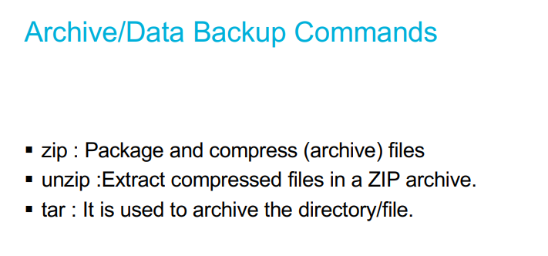

Slide 126
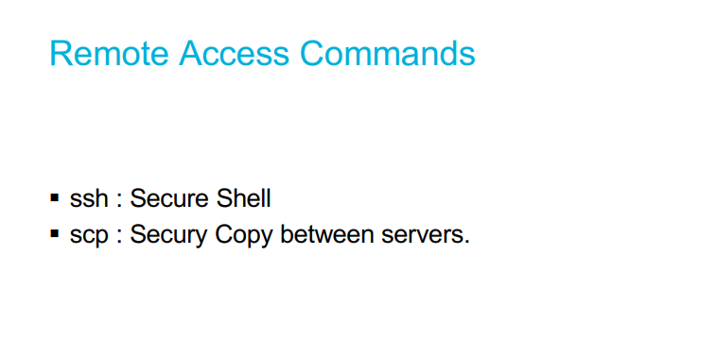

Slide 127

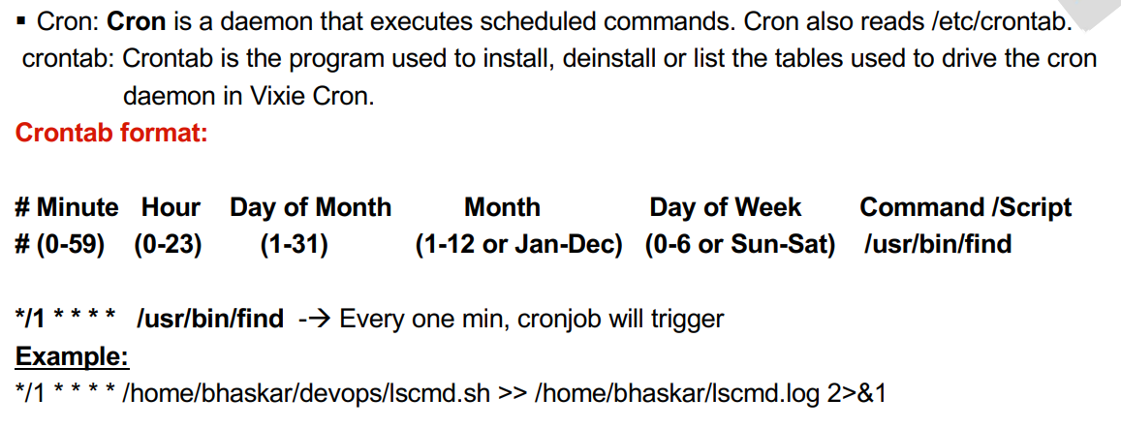

Slide 128


Slide 129
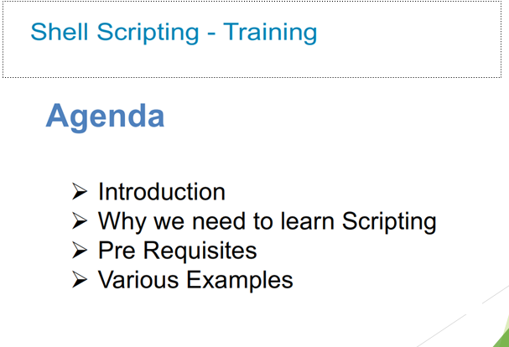

Slide 130
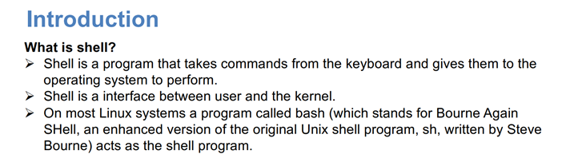

Slide 131
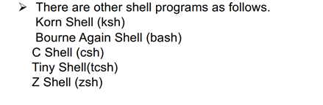
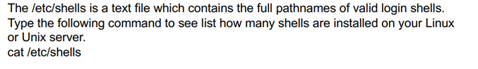
Shell types

Slide 132
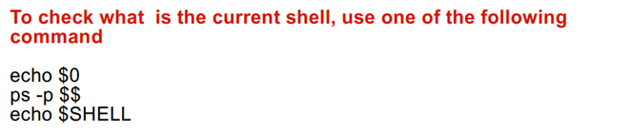
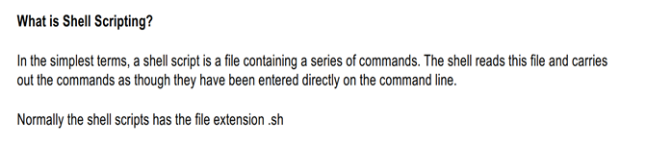

Slide 133
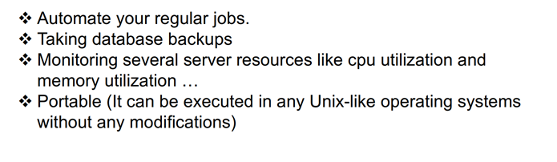
Why we need to Learn ShellScripting

Slide 134
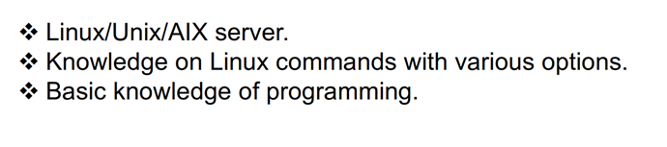
Pre-Requisites

Slide 135
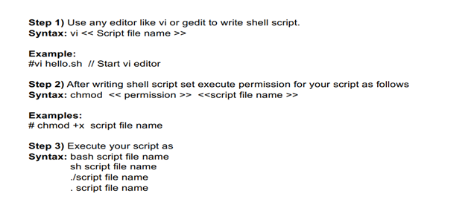
Steps to Write Shell Script

Slide 136
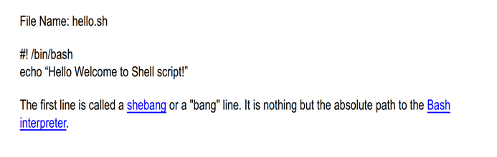
First shell script example

Slide 137
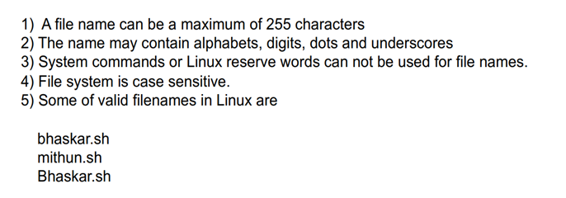
File Naming Conventions

Slide 138
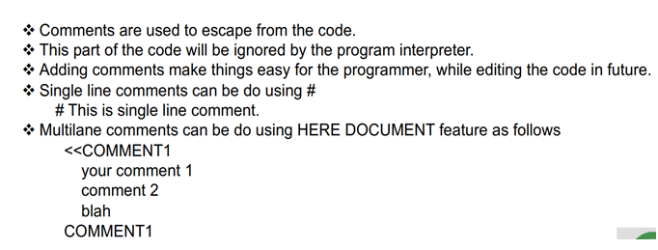
Comments in Shell script

Slide 139
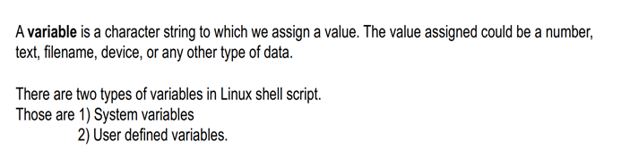
Variables in Shell Script

Slide 140
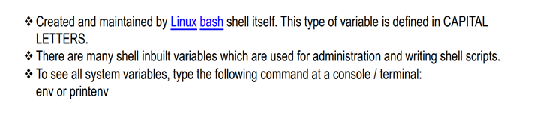
1.System Variables

Slide 141

2.User Defined Variables

Slide 142

Command Line Arguments in Shell Script

Slide 143


String In Shell Script

Slide 144

Arithmetic Operations In Shell Script

Slide 145


Read command in Shell Script

Slide 146



Slide 147

Input and Output Redirection

Slide 148


Slide 149

Control Commands in Shell Script

Slide 150


Slide 151


Slide 152


Slide 153


Slide 154


Slide 155


Slide 156


Slide 157


Functions in Shell Script

Slide 158


Slide 159


Slide 160

Pipes In Shell Script

Slide 161

Pipes example

Slide 162
Table 1: Built-in shell variables.
Variable Use
$# Stores the number of command-line arguments that were passed to the shell program.
$? Stores the exit value of the last command that was executed.
$0 Stores the first word of the entered command (the name of the shell program).
$* Stores all the arguments that were entered on the command line ($1 $2 ...).
"$@" Stores all the arguments that were entered on the command line, individually quoted ("$1" "$2" ...).

Slide 163


Slide 164


Slide 165

DevOps Tools-Phase-1

Slide 166
DevOps Tools
Source Code Management Tools

Slide 167
Popular SCM Tools
Git and Github
Gitlab
SVN
Bitbucket etc…
Most of the companies are using Git and Github.

Slide 168
PreRequisites
Github account needs to be created
Github userid
Download Gitbash

Slide 169
Github Account Creation
Open your web browser and go to the GitHub website: https://github.com.
On the GitHub homepage, click on the "Sign up" button located in the upper-right corner.
You will be presented with two options: "Sign up for GitHub" or "Sign up with Google." Choose the option that suits you best.
If you selected "Sign up for GitHub," you will be prompted to enter your desired username, email address, and password. Choose a username that is unique and reflects your identity or the purpose of your account.
If you selected "Sign up with Google," you will be asked to sign in to your Google account, and GitHub will use the associated email address for your account.
After entering your username, email address, and password, click on the "Create account" button.
GitHub may ask you to verify your email address. Check your email inbox for a verification message from GitHub and follow the instructions provided to verify your email.
Once your email is verified, you will be directed to a page where you can choose your personal plan. GitHub offers both free and paid plans, depending on your needs. Choose the plan that suits you best and click on the "Continue" button.
Next, GitHub will ask you a few optional questions about your experience with programming and your intended use of GitHub. You can choose to answer these questions or skip them by clicking on the "Skip this step" link at the bottom of the page.
Congratulations! You have successfully created your GitHub user ID.
You can now explore GitHub, create repositories, contribute to projects, and collaborate with other developers.

Slide 170


Slide 171

Stages in Git

Slide 172
Git and Github components
What is Git and what are its benefits?
Git is a distributed version control system that allows developers to keep track of changes to code and collaborate with others on software development projects. Its benefits include allowing developers to work on code simultaneously without interfering with each other's work, providing a history of changes to the code, and enabling developers to easily revert to previous versions of the code if needed.
What is GitHub?
GitHub is a web-based hosting service for Git repositories. It provides a user-friendly interface for developers to manage their Git repositories, collaborate with other developers, and contribute to open-source projects.
What is a repository?
A repository, also known as a repo, is a collection of files and directories that make up a project, along with the version history of those files.
What is a commit in Git?A commit is a snapshot of the changes made to the code in a repository at a particular point in time. Each commit has a unique identifier and a message describing the changes made.

Slide 173
Git components
What is branching in Git?
Branching is the process of creating a new line of development from an existing branch. It allows developers to work on multiple versions of the same codebase simultaneously, and to experiment with new features without affecting the main branch.
What is a pull request?
A pull request is a mechanism for developers to submit changes to a project hosted on GitHub. It allows other developers to review the changes and suggest improvements before they are merged into the main branch.
How do you resolve merge conflicts in Git?
Merge conflicts occur when two or more developers make changes to the same file or lines of code. To resolve conflicts, developers must manually edit the affected files and choose which changes to keep and which to discard.

Slide 174
What is a Git stash?
A Git stash is a mechanism for temporarily saving changes to a repository without committing them. It allows developers to switch to a different branch or work on a different feature without losing their current work.
What is a Git tag?
A Git tag is a label applied to a specific commit in a repository. It is used to mark important points in a project's history, such as release versions or milestones.
What is the difference between Git and SVN?
Git is a distributed version control system, while SVN (or Subversion) is a centralized version control system. Git allows developers to work on code simultaneously and keep track of changes locally, while SVN requires a centralized server to store and manage code changes. Additionally, Git is generally considered to be faster and more flexible than SVN.

Slide 175


Slide 176


Slide 177


Slide 178


Slide 179


Slide 180


Slide 181


Slide 182


Slide 183


Slide 184
Automation Build Tools
Maven
Gradle
Ant
Popular Automation Build tool is Maven

Slide 185


Slide 186


Slide 187


Slide 188


Slide 189

POM.xml File

Slide 190


Slide 191


Slide 192


Slide 193


Slide 194


Slide 195


Slide 196


Slide 197


Slide 198
Code Quality Tools
SonarQube
Veracode
Popular Code Quality tool is SonarQube

Slide 199


Slide 200


Slide 201


Slide 202


Slide 203


Slide 204


Slide 205


Slide 206


Slide 207


Slide 208


Slide 209


Slide 210
Artifactory Repositories
Nexus
Jfrog
S3
Harabr
Minio etc
Popular Artifactory Repository is Nexus

Slide 211


Slide 212


Slide 213
PreRequisites
Linux Server
Java
Install Nexus by downloading from website

Slide 214


Slide 215

Nexus Directory Structure

Slide 216


Slide 217


Slide 218


Slide 219

Release Repo
A repository for maven artifact that you deploy without –SNAPSHOT in the end of the version

Slide 220


Slide 221


Slide 223


Slide 224



Slide 225


Slide 226


Slide 227


Slide 228
Pre-Requisites
Linux server
Port 8080 need to Open on Security Group
Install Java
Install Tomcat
Installation Document will share separately

Slide 229


Slide 230


Slide 231


Slide 232


Slide 233


Slide 235
CI: Continuous Integration
It is the combination of continuous build + continuous test
Whenever Developer commits the code using source code management like GIT, then the CI Pipeline gets the change of the code runs automatically build and unit test
Due to integrating the new code with old code,
we can easily get to know the code is a success (or) failure
It finds the errors more quickly
Delivery the products to client more frequently
Developers don’t need to do manual tasks
It reduces the developer time 20% to 30%

Slide 236


Slide 237
CI Server
Here only Build, test & Deploy all these activities are performed in a single CI Server
Overall, CI Server = Build + Test + Deploy

Slide 238
CD: Continuous Delivery/Development
Continuous Delivery
Continuous Deployment
CD is making it available for deployment. Anytime a new build artifact is available, the artifact is automatically placed in the desired environment and deployed
Here, Deploy to production is manual here
CD is when you commit your code then its gets automatically tested, build and deploy on the production server. It does not require approval 99% of customers don’t follow this Here, Deploy to production is automatic.

Slide 239

CI/CD Pipeline

Slide 240
6 Phases
Version Control
Build
Here developers need to write code for web applications. So it needs to be committed using version control system like GIT (or) SVN
Let’s consider your code is written in java, it needs to be compiled before execution. In this build step code gets compiled For build purpose we’re using maven

Slide 241
Unit Test
Deploy
If the build step is completed, then move to testing phase in this step unit step will be done.
Here we can use sonarqube/mvn test
Here, application/program components are perfectly worked/not we will check in this testing Overall, It is code level testing
If the test step is completed, then move to deploy phase
In this step, you can deploy your code in dev, testing environment
Here, you can see your application output
Overall, we are deploying our application in Pre-Prod server. So, Internally we can access

Slide 242
Auto Test
Deploy to Production
Once your code is working fine in testing servers, then we need to do Automation testing
So, overall it is Application level testing
Using Selenium (or) Junit testing
If everything is fine then you can directly deploy your code in production server

Slide 243
Uses of CICD Pipeline
Because of this pipeline, bugs will be reported fast and get rectified so entire development is fast
Here, Overall SDLC will be automatic using Jenkins
Note: If we have error in code then it will give feedback and it will be corrected, if we have error in build then it will give feedback and it will be corrected, pipeline will work like this until it reaches deploy

Slide 245
CICD Tools
Jenkins
Bamboo
Gitlab CI
Circle CI
Teamcity
Popular CICD Tool is Jenkins

Slide 246


Slide 247
what is jenkins
It is an open source project written in Java by kohsuke kawaguchi
The leading open source automation server, Jenkins provides hundreds of plugins to support building, deploying and automating any project.
It is platform independent It is community-supported, free to use
It is used for CI/CD
If we want to use continuous integration first choice is jenkins
It consists of plugins. Through plugins we can do whatever we want. Overall without plugins we can’t run anything in jenkins

Slide 248
Jenkins
It is used to detect the faults in the software development
It automates the code whenever developer commits
It was originally developed by SUN Microsystem in 2004 as HUDSON
HUDSON was an enterprise addition we need to pay for it
The project was renamed jenkins when oracle brought the microsystems
Main thing is It supports master & slave concepts
It can run on any major platform without complexity issues
Whenever developers write code we integrate all the code of all developers at any point int time and we build, test and deliver/deploy it to the client. This is called CI/CD
We can create the pipelines by our own
We have speed release cycles
Jenkins default port number is 8080

Slide 249


Slide 250
Pre-Requisites
Linux server
Install Java
Install jenkins
Enable port 8080 on SG
Installation Document will share by separately

Slide 251


Slide 252

Master & Slave Architecture

Slide 253
Master & Slave Architecture
Here, the communication between these servers, we will use master & slave communication
Here, Master is Jenkins server and Slave is other servers
Jenkins uses a Master-Slave architecture to manage distributed builds.
In this architecture, master & slave nodes communicate through TCP/IP protocol
Using Slaves, the jobs can be distributed and load on master reduces and jenkins can run more
concurrent jobs and can perform more
It allows set up various different environments such as java, .Net, terraform, etc..,
It supports various types of slaves
Linux slaves
Windows slaves
Docker slaves
Kubernetes slaves
ECS (AWS) slaves
If Slaves are not there means by default master only do the work

Slide 254
Jenkins Jobs/Projects
Jenkins is a popular open-source automation server used for building, deploying, and automating projects. Jenkins jobs, also known as Jenkins builds, are the core building blocks of Jenkins automation. Each job defines a specific task or set of tasks to be executed in a Jenkins pipeline. There are various types of Jenkins jobs, each serving a different purpose. Here's an explanation of some common Jenkins job types

Slide 255
Jenkins Jobs/Projects
Freestyle Project
Pipeline
A Freestyle Project is the simplest type of Jenkins job.
It allows you to configure build steps, post-build actions, and triggers through a web-based interface.
It's a good choice for basic tasks like compiling code, running tests, and archiving artifacts.
A Pipeline job, defined using Jenkins Pipeline DSL or by creating a Jenkinsfile, provides more advanced and flexible control over the build process.
It allows you to define the entire build, test, and deployment workflow as code.
Jenkins Pipelines are highly extensible and support stages, parallel execution, and complex build and deployment scenarios

Slide 256
Jenkins Jobs/Projects
Multi-Branch Pipeline
Multi-Configuration Project
Multi-Branch Pipelines automatically create pipelines for multiple branches in a version control system (e.g., Git).
Each branch gets its own pipeline, making it useful for managing CI/CD for projects with multiple feature branches.
This type of job is used for building and testing a project on multiple configurations, such as different platforms, environments, or parameters.
It's helpful for cross-platform testing and compatibility checks.

Slide 257
Jenkins Jobs/Projects
GitHub Organization
Matrix Project
A GitHub Organization job scans GitHub organizations, repositories, and branches to automatically create Jenkins pipeline jobs based on Jenkinsfiles in those repositories.
It simplifies managing Jenkins jobs for multiple projects in a GitHub organization
Matrix Projects allow you to run a job with multiple combinations of axes (parameters) to test various configurations.
It's useful for running a job with different versions of software, platforms, or environments.

Slide 258
Jenkins Jobs/Projects
Copy Artifact from Another Project
Trigger builds remotely (e.g., from scripts)
This job type lets you copy artifacts (files or data) from one Jenkins project to another.
It's useful for transferring build artifacts or configuration files between different build jobs.
This job type allows you to trigger Jenkins jobs externally via an HTTP request.It's useful for integrating Jenkins with other systems or for manual job execution

Slide 259
Jenkins Jobs/Projects
External Job
Declarative, Scripted, or Shared Libraries
An External Job allows you to link to external systems or scripts.
It can be used to integrate Jenkins with other automation tools, making Jenkins a part of a broader automation workflow.
These are variations of Pipeline jobs, specifically designed for Jenkins Pipeline DSL.
Declarative pipelines are easier to read and write, while scripted pipelines offer more advanced control through Groovy scripting.
Shared libraries allow you to reuse and share pipeline code across multiple projects

Slide 260



Slide 261


Slide 262


Slide 263
How are you triggering your jenkins Jobs ?
Jenkins job can be triggered either manually (or) automatically
1. Github Webhook
2. Build Periodically
3. Poll SCM

Slide 264
WebHooks
How to add webhooks from gitHub
Whenever developer commits the code that change will be automatically applied in server. For this, we use WebHooks
Open repository → settings → webhooks → Add webhook
payload URL : jenkinsURL:8080/github-webhook/
Content-type : Application/json
Click on Add webhook
So, we are created webhooks from github Now, we have to activate in jenkins dashboard, here Go to Job → Configure → select below option → save

Slide 265
Schedule the Jobs
Build Periodically
Select one job → configure → build periodically
Here, it is working on “CRON SYNTAX”
Here we have 5 starts i.e. * * * * *
1st star represents minutes
2nd star represents hours [24 hours format]
3rd star represents date
4th star represents month
5th star represents day of the week
i.e.., Sunday – 0
Monday - 1
Tuesday - 2
Wednesday - 3
Thursday - 4
Friday - 5
Saturday - 6

Slide 266
Poll SCM
Select one job → configure → select Poll SCM
It only works whenever the changes happened in “GIT” tool (or) github
We have to mention between the time like 9am-6pm in a day
same it’s also working on cron syntax
Eg: * 9-17 * * *

Slide 267
Difference between WebHooks, Build periodically, Poll SCM
Webhooks:
Whenever developer commits the code, on that time only build will happen
It is 24x7 no time limit
It is also working based on GIT Tool (or) github
Poll SCM:
Same as webhooks, But here we have time limit Only for GIT
Build Periodically:
Automatically build, whether the changes happen/not (24x7)
It is used for all devops tools not only for git
It will support on every work
Every Time as per our schedule

Slide 268

Linked Jobs:This is used when a job is linked with another job
Upstream & Downstream:
An upstream job is a configured project that triggers a project as part of it execution.
A downstream job is a configured project that is triggered as part of a execution of pipeline
So, here I want to run the jobs automatically i.e., here we need to run the 1st job, So automatically job-2,
job-3 has also build. Once the 1st build is done

Slide 269
User Management in Jenkins
For security configuration purpose we’re using user management
1. Security is all about authentication and authorization.
2. By default, jenkins requires username and password to access
3. By default, all new users will have full access
4. Jenkins stored details about users in local file system
a. In the real word we use third party identity management systems such as active directory, LDAP etc.
here, we are having 3 types
a. Role-based strategy
b. Project based Matrix Authorization strategy
c. Matrix-based security (Advanced concept)

Slide 271


Slide 273


Slide 274
History
Michael Dehhan developed Ansible and the ansible project began in feb 2012
Ansible was taken over by Red-Hat
Ansible supports in Linux for all the flavors. i.e., RHEL, Debian, CentOS, Oracle Linux
We can use this tool, whether our servers are in On-Premise (or) in the cloud
Ansible is a simple open-source IT engine which automates application deployment
It is a server configuration management tool
For Server management we are using ansible
Ansible is Orchestration, Security and Compliance
It uses YAML Scripting Language which works on Key-Value pair
So, here for server configure we’re using YAML
Ansible dependency “Python”. It is used python for back end
Ansible GUI is called as Ansible Tower. It is paid version
Instead of this we use playbooks for this
Ansible is having greater community
For Creation of infrastructure also we’re using ansible

Slide 275
Configuration Management
It is a process where we maintain infrastructure and software changes through automation and the goal is to maintain them in a desired state
It saves lots of time and it makes it easy to fix defects if any

Slide 276
Why we’re using Ansible ?
1. While managing the multiple servers it's hard to keep their configuration identical. If you have
multiple servers which needs to configure the same setup in all
while doing the one to one server their might be a chances to miss some configuration steps in some servers
Eg: We are having 10 servers. In this 10 servers we have to set up the tomcat. Generally, tomcat setup contains lot of steps So, it’s little bit hard. For single servers we can do it. If 10 servers we do manually means may be we will miss some steps. so, tomcat fails
That’s why automation tools comes into play.
The automation tools: Ansible, chef, puppet and SaltStack all are based on same principle

